Slide 1


Image 1
Influential Factors that Determine the Price of an Airbnb Listing
Team 1: Parth Dalal, Sneha Kumaran, Moazzam Mansoob, Tanmaya Rodda
Image 2

Slide 2


01
02
03
04
05
Introduction
Background
Problem Statement and Data
Objectives
Research Question
Dataset
Method
Data Exploration
Data Preprocessing and Modeling
Results
Analysis
Related Works
Summary
Conclusion
Future Work

Slide 3
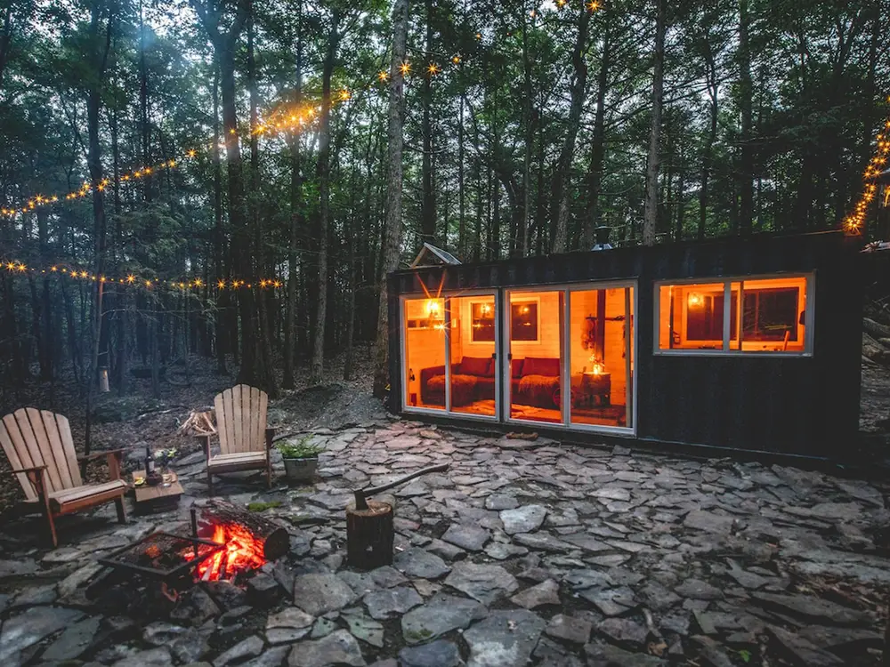
Introduction
Airbnb?
Online marketplace for short or long-term homestays and experiences
Rise of short-term vacation rentals
Personalized experience in comparison to traditional hotels
Demand has increased and skyrocketed
Decision-making and crucial factors by the host impact the bookings and generate income
Elements like location, property characteristics, guest reviews, and pricing model exploration will aim to identify the decision-making processes
Image 4

Slide 4

Problem Statement and Research Question
Objective:
Aim to study and explore the influential factors that affect the pricing on both sides of Airbnb marketplace
Host and Guest/Traveler
Research Questions:
What features determine the price of an Airbnb listing (factors such as reviews, room type, geography, etc.)?
Is there any relation between the price of the listing and the customer review?
Which neighborhood has the highest number of customer reviews?
Image 5

Slide 5
Problem Significance
Understanding the Market Dynamics
Host Optimizations
Enhancing the Guest Experience
Insights for Travelers for decision making
Business and Economic Implications
Holds significance in the economic aspect and broadens the tourism industry
Academic and Research Perspective
Economy
Hospitality Management
Consumer Behaviors
Image 5

Slide 6

Motivation
Personal Experiences as Travelers and Airbnb users
Difficulty in the decision-making process of selecting the perfect accommodation
Economic Significance of Airbnb in Global Tourism
Understanding Airbnb’s impact on economies and incomes for potential hosts
Technological Innovation
Enhance the user experience and shape the decision-making process
Host Empowerment
Entrepreneurship
Image 6

Slide 7

Related Works
“Exploring Sources of Satisfaction and Dissatisfaction in Airbnb Accommodation Using Unsupervised and Supervised Topic Modeling” by Ding, K., Choo, C.W., et al.
“Predicting prices of Airbnb listings via Graph Neural Networks and Document Embeddings: The case of the island of Santorini” by Kanakaris, N. & Karacapilidis, N.
“Airbnb Price Prediction Using Machine Learning and Sentiment Analysis” by Rezazadeh Kalehbasti, Nikolnko, and Rezaei
Image 7

Slide 8
Dataset
Airbnb Open Dataset of New York
Data from 2008
26 columns
csv file
Attributes:
id, Name, host id, host_identity_verified, hostname, neighborhood group, neighborhood, lat, long, country, country code, cancellation_policy, room type, construction year, price, service fee, minimum nights, number of reviews, last review, reviews per month, review rate number, calculated host listings count, availability 365, house_rules, and license
Column Name | Data Type | Description
id | Nominal - Categorical | Unique id per listing
Name | Nominal - Categorical | Name of the listing
Host id | Nominal - Categorical | Host’s unique id
host_identity_verified | Nominal - Categorical | Verified/unconfirmed listing
Table 1. The first 5 columns of the dataset

Slide 9

Method and Approach
Image 8
Tools: Python, Jupyter Notebook, Google Collab
Data Collection and Preprocessing
Compiled a detailed dataset of Airbnb listings
Skimmed through details such as rates, reviews, property characteristics, feedback, neighborhood, geography, and host-related variables
Exploratory Data Analysis
Feature Selection and Engineering
Applied statistical methods (fill null values and labeling categorical values) and selected relevant features that impact pricing
Property size
Reviews
Policies
Location
Reduced noise and outliers
Machine Learning Models
Algorithm: Random Forest Regressor
Offers to give diverse perspectives on data for more comprehensive prediction of Airbnb listings
Evaluation and Validation
RSME
R-Squared

Slide 10
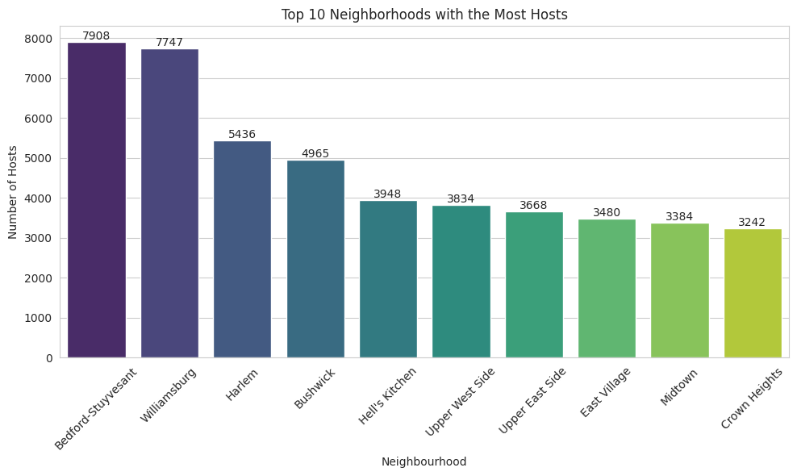
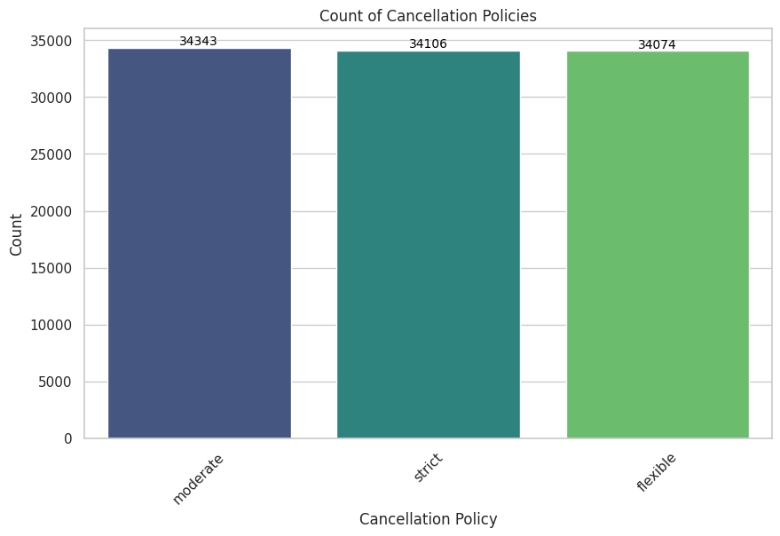
Data Exploration
Figure 1. Top 10 communities with the most hosts
Figure 2. Cancelation policy distribution

Slide 11
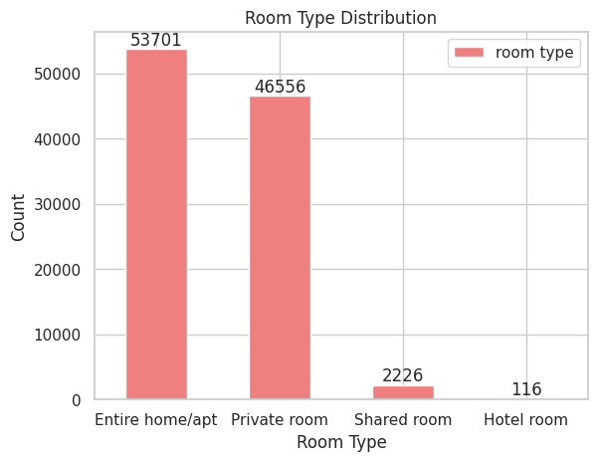
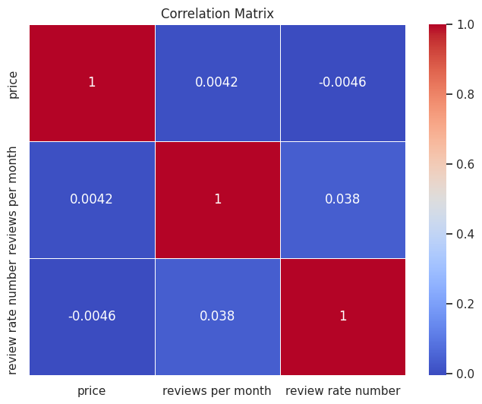
Data Exploration
Figure 3. Room type distribution
Figure 4. Prices vs. monthly reviews

Slide 12
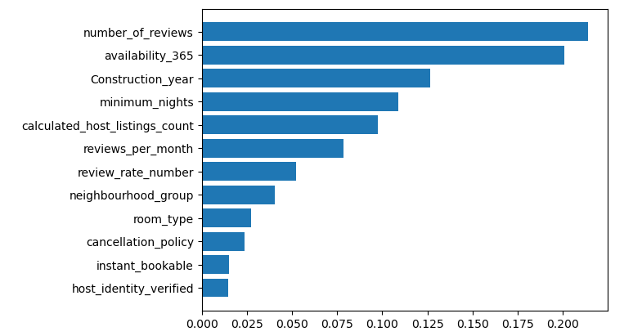
Prediction Model
Labeling Coding and Model Accuracy
Categorical Variables: Encoding categorical variables into a format that machine learning models can understand is crucial for accurate predictions.
Low Model Accuracy: Despite various machine learning approaches, including Random Forest Regressor (R-squared = 0.036), Logistic Classification, and Linear Regression, all models exhibited low accuracy.
Predictable Pricing Variables: Identifying the variables that significantly influence pricing is essential for improving model accuracy.
Figure 5. Feature importance

Slide 13
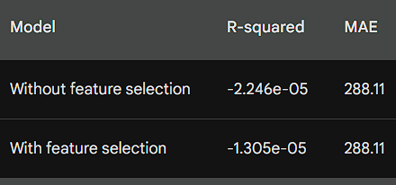
Comparing Linear Regression Models with and without SelectKBest
Linear Regression Model without SelectKBest
The R-squared score for the linear regression model without feature selection is -2.246e-05.
The mean absolute error (MAE) for the linear regression model without feature selection is 288.11.
These results indicate that the linear regression model without feature selection is not very accurate.
Linear Regression Model with SelectKBest
The R-squared score for the linear regression model with feature selection using SelectKBest is -1.305e-05.
The MAE for the linear regression model with feature selection using SelectKBest is 288.11.
These results indicate that the linear regression model with feature selection using SelectKBest is not more accurate than the linear regression model without feature selection.
Figure 6. The MAE for the two models is very similar. This suggests that the difference in accuracy is not very large.

Slide 14
Gradient Boosting Regressor for Airbnb Price Prediction
Gradient Boosting Regressor is an ensemble machine learning algorithm that combines multiple weak decision trees to create a strong prediction model.
Results:
The GBR model achieved an R-squared score of 0.0015, indicating that the model explains a very small proportion of the variance in Airbnb prices.
The MAE, RMSE, and MAPE values suggest that the model has a moderate level of accuracy, with an average absolute error of approximately $288 and an average percentage error of 101.58%.
Conclusion:
The GBR model demonstrates the potential of ensemble machine learning methods for predicting Airbnb prices. However, further improvements in accuracy may require additional data preprocessing, feature engineering, and hyperparameter tuning.

Slide 15
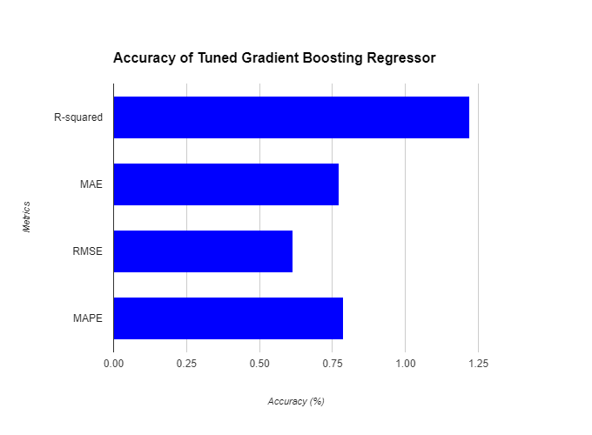
Hyperparameter Tuning and GridSearchCV
GridSearchCV systematically evaluates different combinations of hyperparameter values to identify the optimal set that yields the best performance.
Parameters Evaluated:
Parameter grid 1: R-squared = 0.0041, MAE = 287.42, RMSE = 332.06, MAPE = 101.41
Parameter grid 2: R-squared = 0.0122, MAE = 285.88, RMSE = 330.69, MAPE = 100.84
Best Parameters
Learning rate: 0.075
Max depth: 6
Min samples split: 3
Min samples leaf: 2
N estimators: 125
Improved Predictive Accuracy
Hyperparameter tuning effectively enhanced the GBR model’s predictive accuracy. The tuned model achieved a higher R-squared score (1.22%) and lower error metrics (MAE = 0.77%, RMSE = 0.61%, MAPE = 0.79%), indicating a better fit to the data and improved prediction capabilities.
Figure 7. Accuracy of tuning gradient boosting regressor

Slide 16
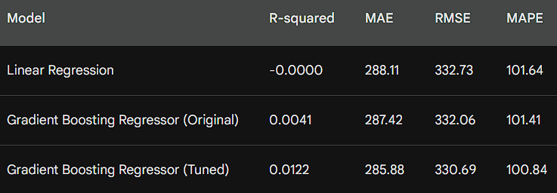
Results and Analysis
Linear Regression
Simple and interpretable model
Limited accuracy (R² = 0.0015)
Cannot capture complex non-linear relationships
Gradient Boosting Regressor (GBR)
Ensemble machine learning algorithm
Improved accuracy (R² = 0.0122)
Captures complex non-linear relationships
Hyperparameter Tuning
Crucial for optimizing model performance
Fine-tunes model's behavior
Enhances generalization to unseen data
Figure 8. Statistics on Linear Regression Model

Slide 17

Conclusion
Which neighborhood has the highest number of customer reviews? 🡪 Brooklyn and Queens for NYC dataset
What features determine the price of an Airbnb listing? 🡪 Figure 5.
Is there any relation between the price of the listing and the customer review? 🡪 The number of reviews plays a role in pricing
Figure 5. Feature importance
Figure 4. Prices vs. monthly reviews

Slide 18

Future Work
Dataset
Other locations
Pre-processing
More advanced machine-learning techniques
Sentiment analysis & NLP
Graph neural networks
Image 9

Slide 19
References - Literature Review and Dataset
Azmoudeh, A. (2022, August 1). Airbnb open data. Kaggle. https://www.kaggle.com/datasets/arianazmoudeh/airbnbopendata?resource=download&select=Airbnb_Open_Data.csv
Ding, K., Choo, C.W., et al., (2021, April 21) Exploring sources of satisfaction and dissatisfaction in Airbnb accommodation using unsupervised and supervised topic modeling https://doi.org/10.3389/fpsyg.2021.659481
Kanakaris, N., & Karacapilidis, N. (2023). Predicting prices of Airbnb listings via graph neural networks and document embeddings: The case of the island of Santorini. Procedia Computer Science, 219, 705–712. https://doi.org/10.1016/j.procs.2023.01.342
Rezazadeh Kalehbasti, P., Nikolenko, L., & Rezaei, H. (2021, August). Airbnb price prediction using machine learning and sentiment analysis. In International Cross-Domain Conference for Machine Learning and Knowledge Extraction (pp. 173-184). Cham: Springer International Publishing.

Slide 20
References - Images
Image 1: Claire Ballentine & Olivia Carville. (2019, June 25). Airbnb’s New Luxe Tier Includes a $1 Million Polynesian Island. Bloomberg. https://www.bloomberg.com/news/articles/2019-06-25/airbnb-luxe-now-renting-luxury-villas-private-islands-mansions
Image 2: DesignStudio. (2014). English: Airbnb’s logo since July 2014. Airbnb’s Design Department. https://commons.wikimedia.org/wiki/File:Airbnb_Logo_B%C3%A9lo.svg
Image 3: Airbnb Wallpapers. (n.d.). Wallpaper Cave. Retrieved December 1, 2023, from https://wallpapercave.com/airbnb-wallpapers
Image 4: Emily Hochberg & Hannah Freedman. (2021, July 16). 12 cozy cabins, cottages, and barns on Airbnb in Upstate New York for a remote retreat immersed in nature. Business Insider: Reviews. https://www.insider.com/guides/travel/affordable-airbnb-cabins-upstate-new-york
Image 5: Vecchio, F. D. & Silvina Rodriguez Picaro. (n.d.). How to turn a great idea into reality. Foroalfa. Retrieved December 1, 2023, from https://foroalfa.org/en/articles/some-ideas-are-too-big
Image 6: Dominika Sarnecka. (2019, October 16). Airbnb – Stay in a home away from home wherever you travel. Digital Innovation and Transformation: MBA Student Perspectives. https://d3.harvard.edu/platform-digit/submission/airbnb-stay-in-a-home-away-from-home-wherever-you-travel/
Image 7: Cobb, J. (2021, November 19). For creative problem solving, bust these 6 perceptual blocks. Mission to Learn. https://www.missiontolearn.com/creative-problem-solving/
Image 8: Cobb, J. (2021, November 19). For creative problem solving, bust these 6 perceptual blocks. Mission to Learn. https://www.missiontolearn.com/creative-problem-solving/
Image 9: Lovich, D. (2021, March 3). The Many Benefits Of Employees Designing The Future Of Work. Forbes. https://www.forbes.com/sites/deborahlovich/2021/03/03/the-many-benefits-of-employees-designing-the-future-of-work/

Slide 21
Thank you
Image 3

